Slide 1


Mobile Price Prediction
Jahedur Rahman
Data Science, Bellevue University
DSC 680: Applied Data Science
Professor Catie Williams
September 18, 2022
Notes:
Hello everyone.
My name is Jahedur Rahman, and I am here to talk to you about a project I worked on called Mobile Price Prediction.

Slide 2

Background/History
Price of a phone differs based on features/specifications
High-end phones have the best specifications
Low-end and mid-range phones don’t have the best specifications
This difference helps target different types of customers
Notes:
Here is some background and history about this project.
Many of us use a smartphone in our daily lives.
The price of each of our smartphones differ.
Some our cheaper and some are more expensive.
The price of the phone is mostly based on the specifications and features that are built into the device.
Phones with the best and most high-end features are expensive,
While phones that don’t have the best features are more budget friendly.
This difference helps target different types of customers.

Slide 3

Business Problem
Companies must be able to predict the price range of a phone they want to make and sell.
Can help decide their target audience/customers
The model will be able to predict the price range of a mobile device based on the features and specifications included.
Notes:
The business problem is that companies must be able to predict the price range of a phone they want to make and sell.
Using the specifications and features of a device they must find the best and most competitive price to place on a phone.
In addition, this can help decide the target audience and/or customers.
The model that has been built will be able to predict the price range of a mobile device based on the features and specifications included.

Slide 4
Dataset
The Mobile Price Classification dataset is the primary dataset
battery_power - Total energy a battery can store in one time measured in mAh
blue - Has bluetooth or not
clock_speed - speed at which microprocessor executes instructions
dual_sim - Has dual sim support or not
fc - Front Camera mega pixels
four_g - Has 4G or not
int_memory - Internal Memory in Gigabytes
m_dep - Mobile Depth in cm
mobile_wt - Weight of mobile phone
n_cores - Number of cores of processor
pc - Primary Camera mega pixels
px_height - Pixel Resolution Height
px_width - Pixel Resolution Width
ram - Random Access Memory in Mega Bytes
sc_h - Screen Height of mobile in cm
sc_w - Screen Width of mobile in cm
talk_time - longest time that a single battery charge will last when you are talking
three_g - Has 3G or not
touch_screen - Has touch screen or not
wifi - Has wifi or not
price_range - 0(low cost), 1(medium cost), 2(high cost) and 3(very high cost)
Notes:
The dataset I am using is the Mobile Price Classification dataset found on Kaggle.
This dataset has 21 columns.
During the data preparation process none of the columns were removed since all of them were important features a phone might have.
Some examples of important features include battery power, clock speed, Front Camera mega pixels, Primary Camera mega pixels, Internal Memory in Gigabytes, ram, and the price range.
In addition, there were no null values, so no records or rows had to be removed.
The target variable in this dataset is the price_range column.
There are four price range values.
The price range value of 0 is a low cost,
The price range value of 1 is a medium cost,
The price range value of 2 is a high cost,
and The price range value of 3 is a very high cost.

Slide 5
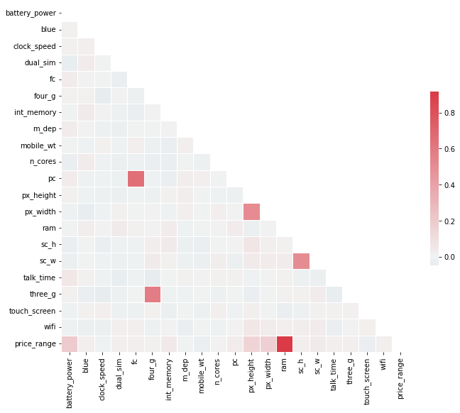
Methods and Analysis
Strong correlation between ram and price range
Correlation between:
Front Camera mega pixels and Primary Camera mega pixels
4G and 3G
Pixel Resolution Height and Pixel Resolution Width
Screen Height and Screen Width
Price range and battery power
Notes:
Before modeling the dataset,
I did some analysis to the dataset.
I wanted to find if there were any correlations between the variables in the dataset.
The heatmap shown on this slide is a visual representation of the correlations between each variable.
A square with a red color interprets to a strong correlation between the two variables that cross that square.
A square with a white or lighter color interprets to a weak or no correlation between the two variables that cross that square.
We can see here that there is a strong correlation between ram and price range.
This tells us that the amount of ram in a phone has a big effect on the given price of a phone
In addition, there is a correlation between
Front Camera mega pixels and Primary Camera mega pixels
4G and 3G
Pixel Resolution Height and Pixel Resolution Width
Screen Height and Screen Width
Price range and battery power
The battery power of a phone also has somewhat of an effect on the price of the phone.

Slide 6
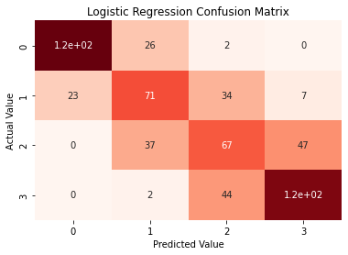
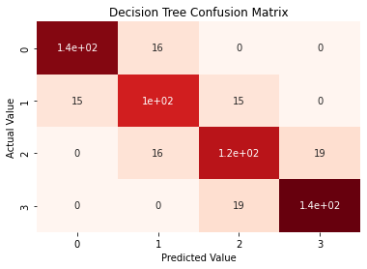
Methods and Analysis
Logistic Regression Model
63% accuracy score
Correctly predicted 378 out of 600 values
Incorrectly predicted 222 out of 600 values
Decision Tree Classifier
83% accuracy score
Correctly predicted 500 out of 600 values
Incorrectly predicted 100 out of 600 values
Notes:
Now time to talk about modeling the data.
I built and tested three different types of modeling algorithms
The first modeling algorithm I built was a logistic regression model.
The results of the model produced a 63% accuracy score.
In addition, the heatmap shows that the model correctly predicted 378 out of 600 values
And incorrectly predicted 222 out of 600 values
To compare these results I built two other models, the Random Forest Classifier and the Decision Tree Classifier
During the modeling process I built the Random Forest Classifier second
However I want to talk about the Decision Tree Classifier now and talk about the Random Forest Classifier in the next slide
The Decision Tree Classifier produced an accuracy score of 83%
the heatmap shows that the model correctly predicted 500 out of 600 values
And incorrectly predicted 100 out of 600 values
These results are better than the logistic regression model.
Now lets look at the Random Forest Classifier

Slide 7

Methods and Analysis
Random Forest Classifier
87.5% accuracy score
Correctly predicted 530 out of 605
Incorrectly predicted 75 out of 605 values
This model had the best results when comparing all three
Notes:
The Random Forest Classifier produced an accuracy score of 87.5%
the heatmap shows that the model correctly predicted 530 out of 605
And incorrectly predicted 75 out of 605 values
These results are much better than the results produced by the logistic regression model
And a little better than the results produced by the decision tree classifier

Slide 8
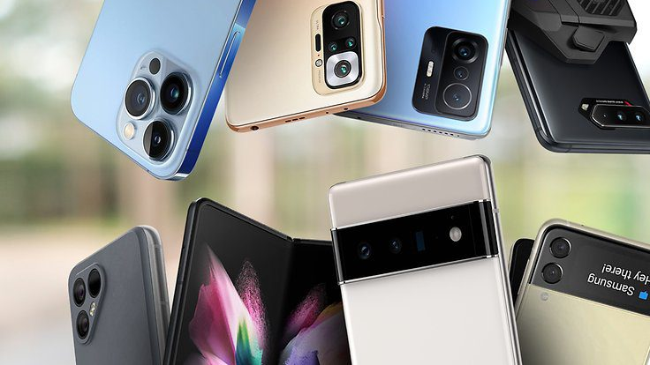
Conclusion
Random Forest Classifier predicts the price range accurately
The model can be used to figure out a competitive price to place on a phone based on the specification and features it has.
As phones are updated with new features and specifications, the model must be updated as well to remain accurate.

